Slide 1
English2MindMap

Slide 2

Agenda
Introduction
Previous Work
Problem Definition
Objective
Work Phases
Conclusion
Future Work
Tools
References

Slide 3
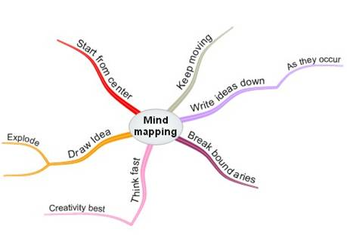
What is a mind map?
A diagram used to represent words, ideas, tasks, or other items linked to and arranged around a central key word or idea.
Notes:
Images and stuff

Slide 4
What is a mind map?
Mind Maps are a way of representing associated thoughts with symbols rather than with unrelated words.
The mind forms associations almost instantaneously, and "mapping" allows you to write your ideas quicker than expressing them using only words or phrases.

Slide 5
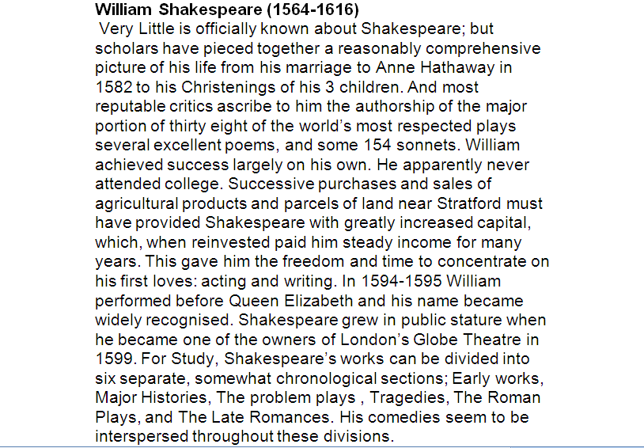
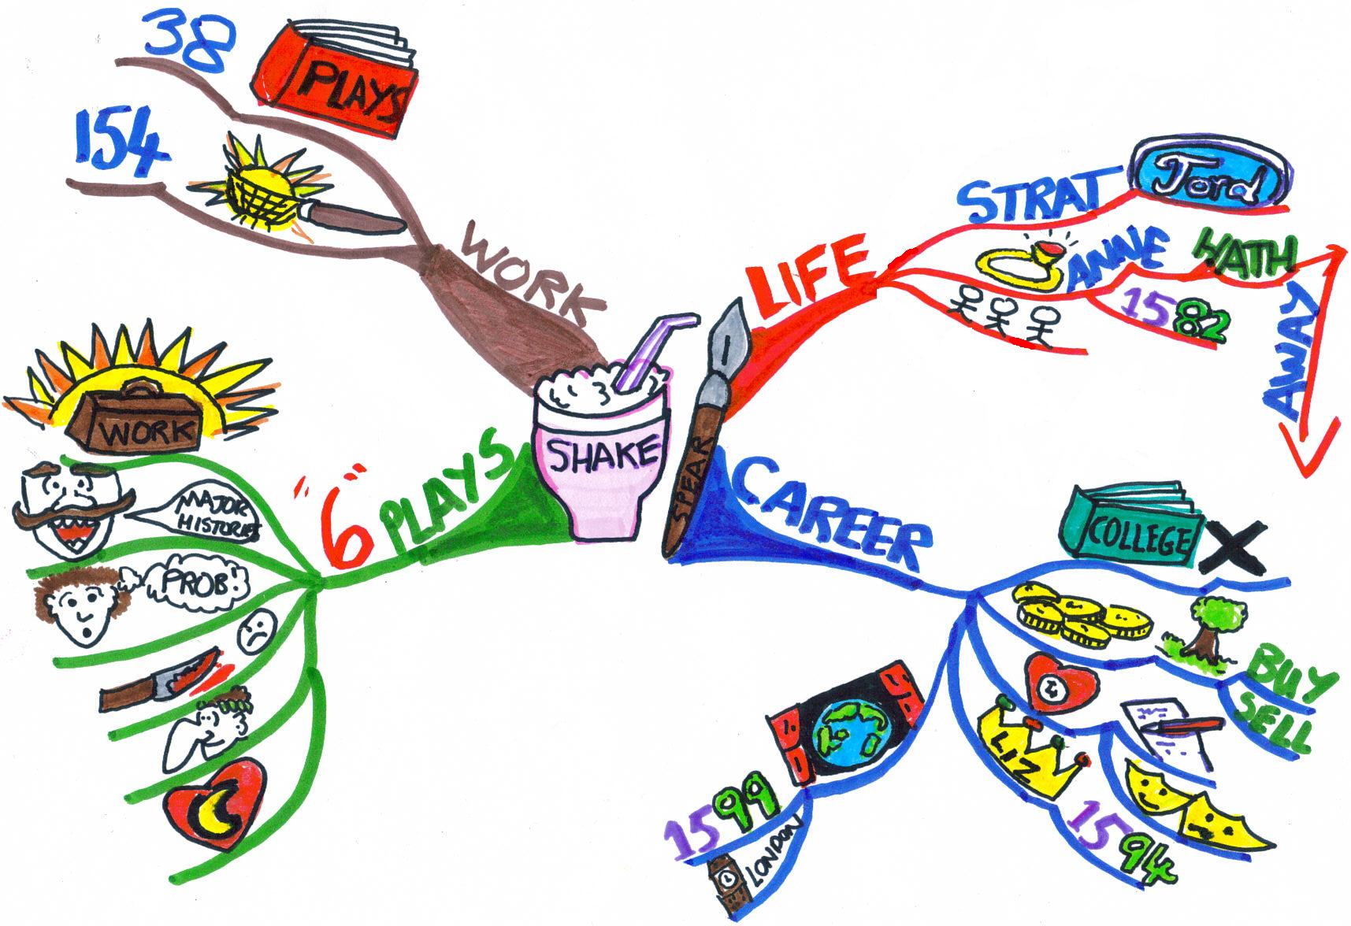
A mind map is created around a single word, placed in the center, to which associated ideas, words and concepts are added branching out.
Notes:
Could use another better looking example

Slide 6
Why use mind maps ?
To generate, visualize, structure, and classify ideas
Also…
British popular psychology author Tony Buzan argues that while 'traditional' outlines force readers to go left to right from top to bottom, while readers actually tend to scan the entire page in a non-linear fashion to get the main topic and what the text discusses.
He also uses popular assumptions about the cerebral hemispheres in order to promote the exclusive use of mind mapping over other forms of note making.
Notes:
Could then elaborate on his idea with a diagram or so

Slide 7

Why use mind maps ? (Cont’d)
Our brain is divided into two hemispheres:
The left hemisphere:
which is responsible for words, calculations, logic , numbers and thinking.
The right hemisphere:
which is responsible for all colors, imagination ,drawing, voice , music and feelings.
Notes:
Roger Sperry: was a neuropsychologist, neurobiologist and Nobel laureate who won the 1981 Nobel Prize in Medicine for his work with split-brain research.

Slide 8
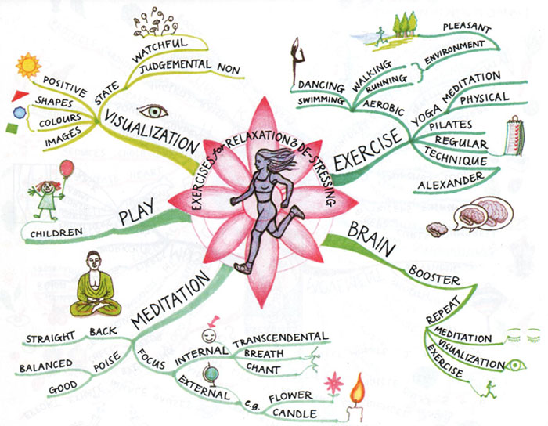
Buzan claims that using mind mapping
allows the best use of both the left and right halves of the brain leading to multiplying the intellectual power

Slide 10
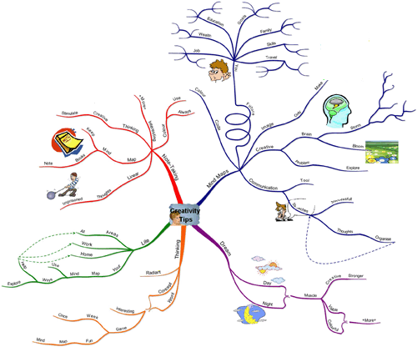
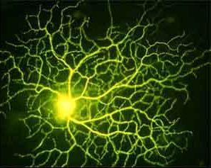

Slide 11

Creating Mind Maps
Mind maps can be drawn by hand

Slide 12


Slide 13
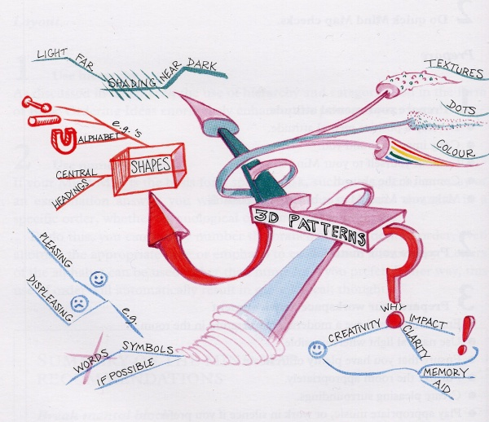

Slide 14


Mind Maps can be drawn using one of the available computer softwares which help the user in drawing the mind map.
Examples of these softwares:
Mind Mapper
Solution Language Tool
Text2MindMap

Slide 15
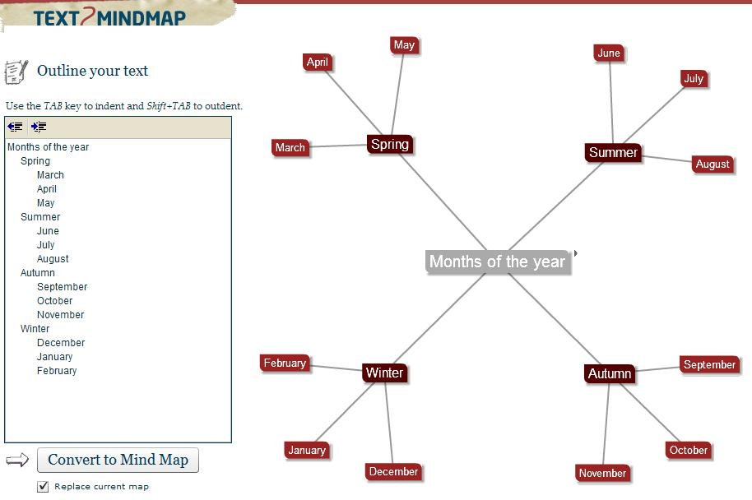

Slide 16
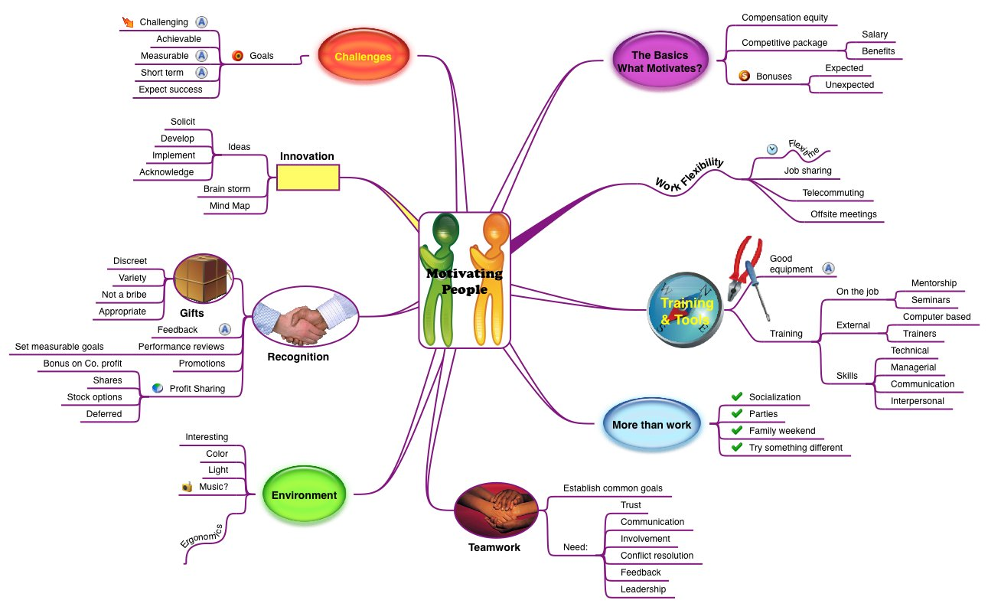

Slide 17
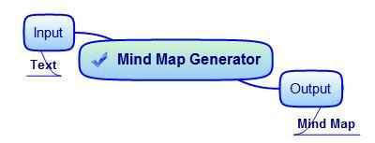
Mind Map Generator 2007/2008

Slide 18
Mind Map Generator 2007/2008 Limitations
It only takes simple text.
Produced a single leveled mind map.
The output was crammed.
Notes:
New Contributions: Accept docs of complex English rules also.

Slide 19
New Contributions
Generate an automatically laid out
multileveled mind map from text of longer sentences.

Slide 20
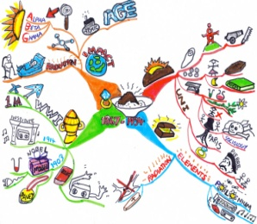
Plain English Text
Text PreProcessing Module
Meaning Representation
Multilevel Generation
Mind Map Conversion
Automatic Layout Allocation
Mind Map

Slide 21
Text PreProcessing Module (previous work)
Morphological Analysis
Parsing
Syntax Analysis
Discourse
Word Sense Disambiguation

Slide 22
Morphological Analysis
Concerned with how words are constructed from more basic meaning units called morphemes .
For example :
Friendly(Adj.) = friend ( n.) + ly(suffix)
“rabbits” has two units which contribute to the meaning of the word:
‘rabbit’ →contributes the main meaning.
‘s’ →adds the information that the word is plural.
Notes:
May put more examples

Slide 23
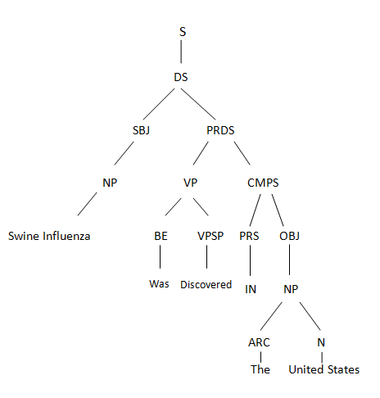
Parsing
the process in which all possible parse trees of a sentence are built.
Notes:
Tree rep. example from net.

Slide 24
Syntax Analysis
the module which produce the final correct parse trees for each sentence in the input text.
Works by :
Assigning weights to each parse tree and the tree with the highest weight will be chosen as the
most perfect tree for the sentence .

Slide 25
Discourse
This task is concerned with assigning each pronoun to the noun which this pronoun refers to.
Example:
Mobile phones have become the most essential means of communication. They have become a part of everyday life for many individuals.

Slide 26
Word Sense Disambiguation
This task is concerned with assigning the most proper sense (meaning) for each word according to the formulation of the sentence
Using WordNet

Slide 27
Plain English Text
Frontend
Meaning Representation
Multilevel Generation
Mind Map Conversion
Automatic Layout Allocation
Mind Map

Slide 28
Meaning Representation
What is Meaning Representation?
It’s a data structure
Puts text in a format that best represents its meaning
Enables the computer to understand:
The meaning of the words in a sentence
What the words stand for
The relations between words in a sentence

Slide 29
Meaning Representation Example
Sentence:
Cleansers for hands can be used when soap and water are unavailable

Slide 30
Hands
Purpose
Cleansers
Unavailable
Theme
Adjective
Used
Condition
Soap
Condition
Water
Unavailable
Adj
Notes:
Change the representation

Slide 31
Meaning Representation Reconstruction
Why the reconstruction?
Parser rules have been modified to accept a wider range and complex forms of English sentences. So….
The parse trees generated changed.
The TMR was reconstructed to adapt to these changes and accept these complex forms.
Notes:
Explain the how to

Slide 32
How We Built The Meaning Representation
Depending on the chosen parse trees’ structures.
Verbs and whether they are active or passive.
Using ontology when prepositions are encountered to assign caseroles.
Each word in ontology has a concept and each concept has properties
Depending on the properties set and prepositions, caseroles are assigned.

Slide 33
Plain English Text
Frontend
Meaning Representation
Multilevel Generation
Mind Map Conversion
Automatic Layout Allocation
Mind Map

Slide 34
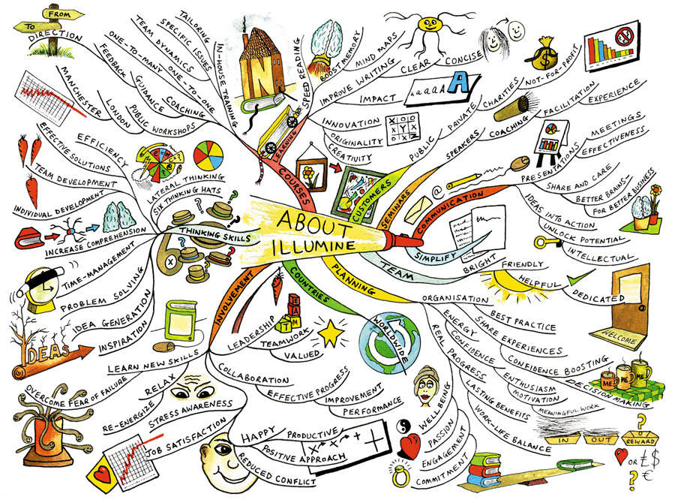
Why Multilevel Mind Mapping?
Totally defying the purpose of…
Comprehension speed
Simplicity
Clarity

Slide 35
What we want to achieve..
G
A
B
C
D
E
F
G

Slide 36
Phases of Multilevel Generation
Text Meaning Representation
Weight Assignment
Weight-Based Partitioning
Concept-Based Partitioning
New Text Meaning Representation

Slide 37
Weight Assignment
We assign weights to each noun and verb.
The most important, relevant nouns and verbs rank the highest.
Why do so?
For the decision making of which to keep, which to eliminate, and which to move on to another level.

Slide 38
Weight Assignment (Cont’d)
How we’ll do it…
Using case role relations we rank the more relevant nouns higher than the others.
Using the nouns and their rankings we rank the verbs.

Slide 39
Weight-Based Partitioning
We group the nouns according to their weights.
We cluster their weights using K-Means++.
The nouns corresponding to the cluster with the highest centroid are marked as the main noun frames.

Slide 40
Concept-Based Partitioning
The actions of each main noun frame are grouped according to an ontology.
An ontology is a formal representation of a set of concepts within a domain.
The semantically related actions are grouped.

Slide 41
Concept-Based Partitioning (Cont’d)
DRUG – PILL – TREAT – HEADACHE – CURE - COUGH – HEAL – SNEEZE
MEDICAL-EVENT {TREAT – CURE – HEAL}
MEDICAL-ARTIFACT {DRUG – PILL}
ANIMAL-SYMPTOM {HEADACHE – COUGH – SNEEZE}

Slide 42
Plain English Text
Frontend
Meaning Representation
Multilevel Generation
Mind Map Conversion
Automatic Layout Allocation
Mind Map
Notes:
Zabbat animation

Slide 43
Mind Map conversion
This phase converts the obtained multileveled text meaning representation into a mind map that contains images
Using Google Images

Slide 44
Plain English Text
Frontend
Meaning Representation
Multilevel Generation
Mind Map Conversion
Automatic Layout Allocation
Mind Map

Slide 45
Automatic Layout Allocation (Cont’d)
Spring Model Algorithm
Replaces edges with springs.
Springs attract their endpoints when stretched
Springs repel their endpoints when compressed.
The vertices are initially placed randomly .
Differential equations are solved to find the system state with minimum energy.

Slide 46
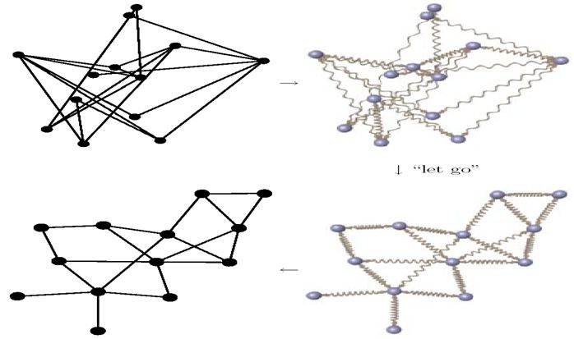
Spring Model

Slide 47
Demo

Slide 48

Conclusion (cont’d)
Mind Map Generator is a tool to automatically generate mind maps from plain English text
It is able to process longer sentences with more complex grammar

Slide 49
Conclusion (cont’d)
The output
A multileveled mind map
The mind map automatically laid out on the screen.

Slide 50
Thank You

